Slide 1



FREPA – MALEDIVE - PluriMobil
Workshop
Eija Aalto, Mirjam Egli Cuenat, Michel Candelier
10 – 11 December 2015, Graz

Slide 2
Structure of the workshop
Activity 1: Basic tasks with pluri-touch
Presentation of the project Maledive
Activity 2: Drawing the „Culturally Diverse You“
Presentation of the project PluriMobil
Presentation of teh project FREPA
Comments, questions, needs, ideas

Slide 3

Activity 1: Basic tasks with pluri-touch
Complete the tasks on the left in as many languages as you can.
What added value does the plurilingual approach bring to these task types that are frequently used in the language of schooling classrooms?
How does the plurilingual approach foster and advance the learning of core skills and content in the language of schooling classroom?
Change the verbs into nouns.
Model: intend → intention
advertise →
inspire →
develop →
Work with a partner and think of as many synonyms as you can for the words given.
  a. a girl b. a boy
http://maledive.ecml.at

Slide 4
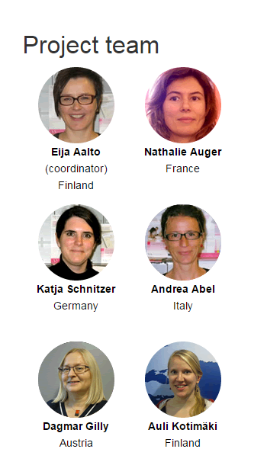


Maledive project:
Teaching the language of schooling in the context of diversity
Study materials for teacher education

Slide 5
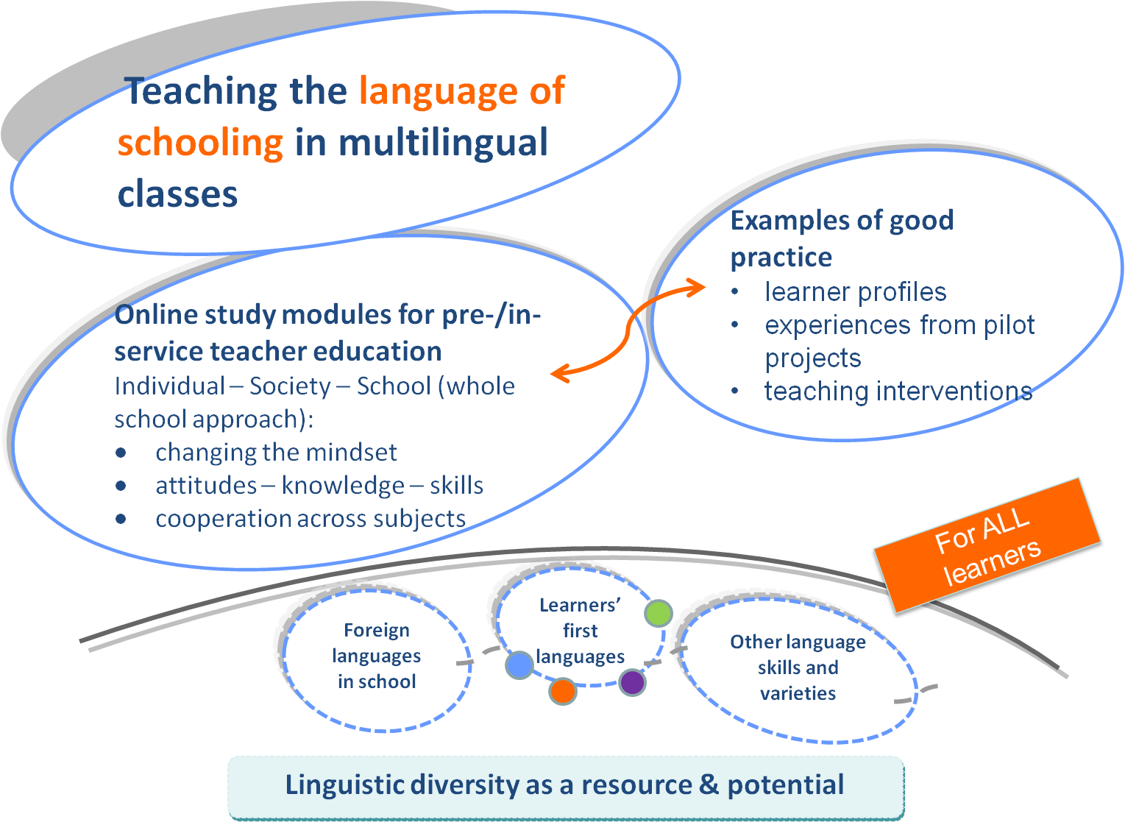
The project in a nutshell

Slide 6
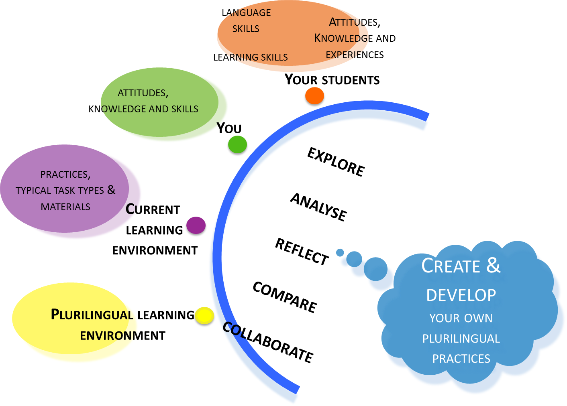
What to learn through the activities?

Slide 7
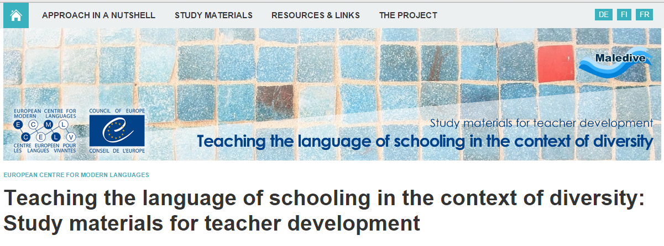
http://maledive.ecml.at

Slide 8
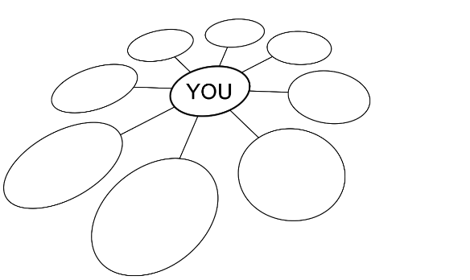
Activity 2: Drawing the „Culturally Diverse You“
Put your first name or initials in one of the circles.
Add new circles.
Write words in the circles you think describe you / are an important part of who you are or how you identify yourself with others (e.g. brother, student, Irish, Christian, Socialist etc.)
If you had just to pick up one circle....
How might these circles change when you are abroad?
PluriMobil Lesson Plan 2 for upper secondary education „My multiple identity“ http://plurimobil.ecml.at
Activity based on an idea from Paige, M. R./Cohen, A. D. et al., 2006

Slide 9
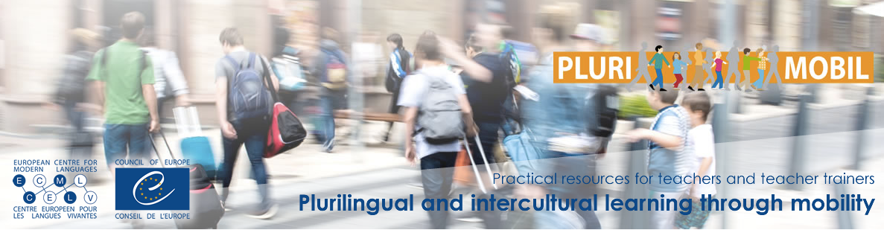
Plurilingual and intercultural learning through mobility: Practical resources for teachers and teacher trainers

Slide 10

What is PluriMobil?
a teaching tool
activities and materials to support the plurilingual and intercultural learning of students
before, during and after a mobility activity
can be adapted to multiple mobility projects across all educational levels
Notes:
PluriMobil is a teaching tool that offers activities and materials to support the plurilingual and intercultural learning of students for the phases before, during and after a mobility activity.
This tool can be adapted to multiple mobility projects across all educational levels.

Slide 11
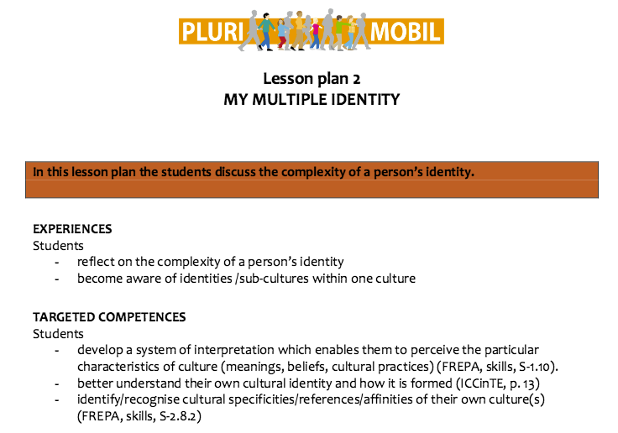

Slide 12
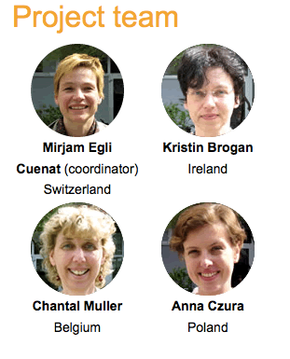
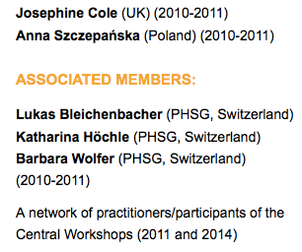
Notes:
Diese Folie neu machen. Weiss noch nicht wie das Plurimobil eingebunden wird. Oberer Teil der Hintergrundinfo weglassen, dafür Konzept und Lessonplans vorstellen.

Slide 13
Aims of PluriMobil
improve students’ communicative and plurilingual skills
enhance their intercultural competence
expand their language awareness and language learning strategies
enable the vocational school students to communicate effectively in a variety of work-related settings
develop teaching skills (in the case of student teachers)
Used tools – e.g.
European Language Portfolio (ELP)
Autobiography of Intercultural Encounters (AIE)
Framework of Reference for Pluralistic Approaches to Languages and Cultures (FREPA/CARAP)
European Portfolio for Student Teachers of Languages (EPOSTL).(EPOSTL/EPOSA)

Slide 14
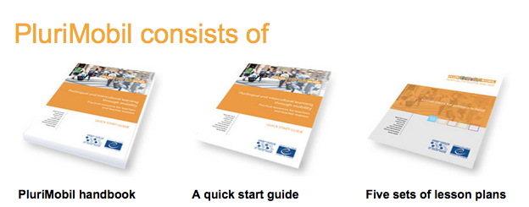
http://plurimobil.ecml.at
Notes:
Diese Folie neu machen. Weiss noch nicht wie das Plurimobil eingebunden wird. Oberer Teil der Hintergrundinfo weglassen, dafür Konzept und Lessonplans vorstellen.

Slide 15
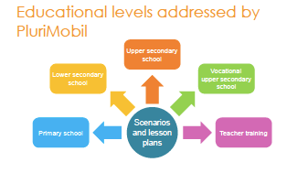

Slide 16
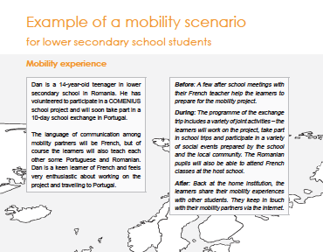

Mobility scenario

Slide 17
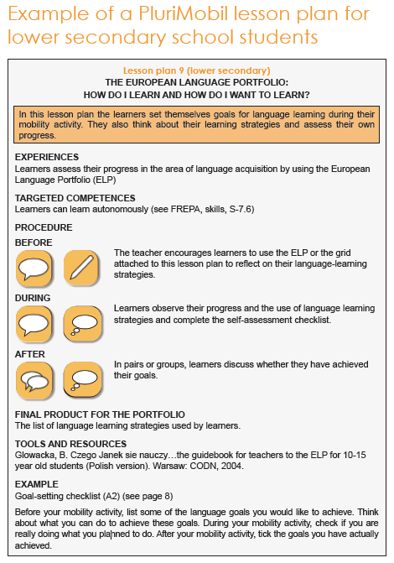
PluriMobil Quick start guide
Notes:
Hier würde ich die Themenbeispiele beschränken und nur auf 2-3 gehen.(My learning diary unbedingt und noch etwas anderes)

Slide 18
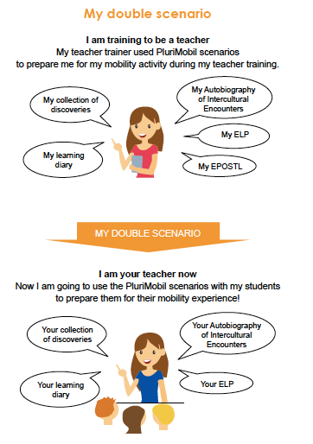

Student teachers, as future teachers, integrate more easily into their teaching practice what they have experienced themselves during their own education and training.
PluriMobil Handbook, p. 28

Slide 19
Plurilingual and intercultural learning through mobility: Practical resources for teachers and teacher trainers
http://plurimobil.ecml.at

Slide 20

FREPA - A Framework of Reference
for Pluralistic Approaches to Languages and Cultures
Key documents on the Framework of Reference for Pluralistic Approaches to Languages and Cultures (CARAP/FREPA)
Online teaching materials database
Training kit for teachers
Notes:
The set of instruments developed by the FREPA team opens ways for developing plurilingual and intercultural competences of learners of all ages, from early learners and adult learners – and in all contexts, e.g. “normal” schools, bilingual schooling, minority language contexts, (re-) migrant learners, European schools, vocational training.

Slide 21


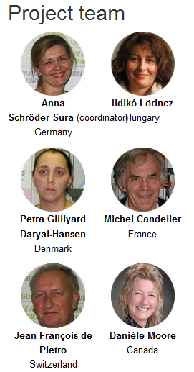
+ Anna Maria Curci, LEND (Movimento di Lingua e Nuova Didattica), Italy
+ Brigitte Gerber, University of Geneva, Switzerland
+ Networks in several European countries
Notes:
composition of the last team

Slide 22
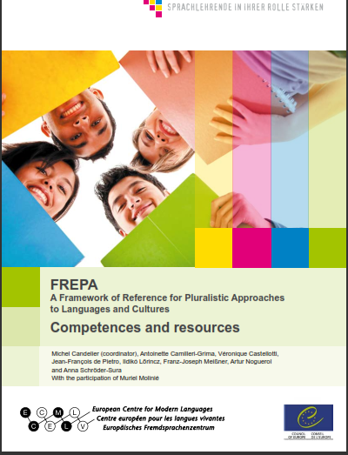
What are pluralistic approaches?
Didactic approaches which use learning/teaching activities involving several (i.e. more than one) varieties of language or cultures
• awakening to languages
• intercomprehension of related languages
• the integrated didactic approach
• intercultural approaches
The FREPA lists plurilingual and intercultural competences as well as resources (Knowledge, Attitudes and Skills) that can be developed by pluralistic approaches

Slide 23
Aims of the FREPA project
dissemination of pluralistic approaches
to make explicit through descriptors the objectives pertaining to plurilingual and intercultural education
a systematic curricular articulation between communicative language learning within specific languages and pluralistic approaches as well as between pluralistic approaches themselves
recognition for the value of pluralistic approaches
Notes:
Which are necessary – as I will show below- for developing the plurilingual and intercultural competence as definded by the CEFR

Slide 24
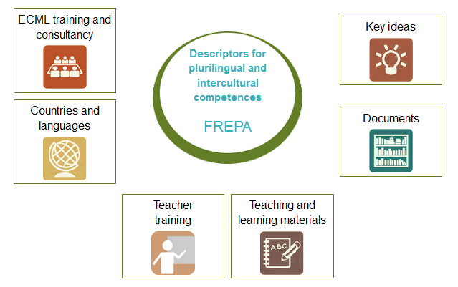
FREPA components
http://carap.ecml.at/

Slide 25
FREPA descriptors
Activity 1: Basic tasks with „pluri-touch“
Knows that there is no word for word equivalence from one language to another (K 6.6)
Curiosity about discovering how (one‘s own / other) language(s) work(s) (A 3.2)
Can observe/analyse writing systems (S 1.3)
Can apply procedures for making comparisons (S 3.1)
Activity 2: Drawing the „Culturally Diverse You“
Knows that one can have a multiple / plural / composite identity (K 14.3)
Being aware of traces of otherness in a language / a culture (A 2.2.3)
Accepting a bi/plurilingual / a bi/plurucultural identity (A 16.2.2)
Can identify one’s own cultural specificities / affiliations (S 2.8.2)

Slide 26
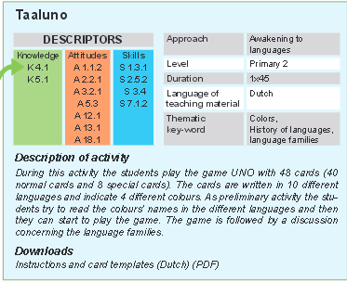
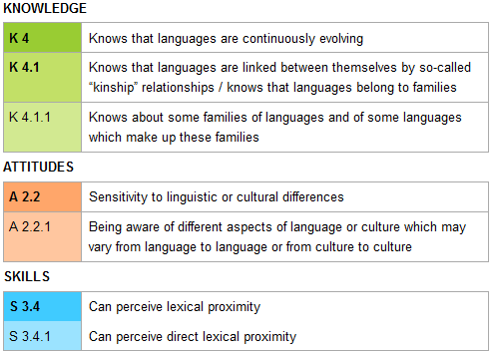
Example of using FREPA

Slide 27
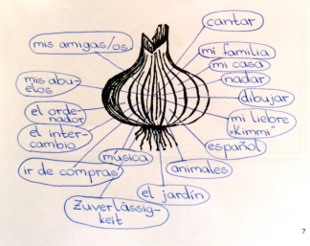
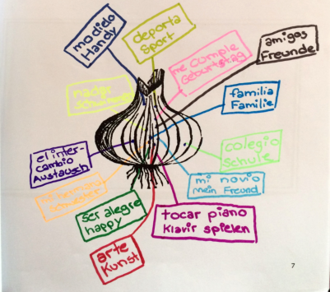

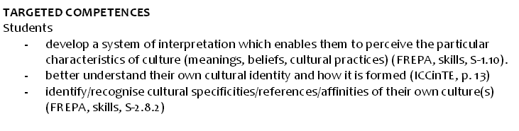
FREPA meets PluriMobil

Slide 28
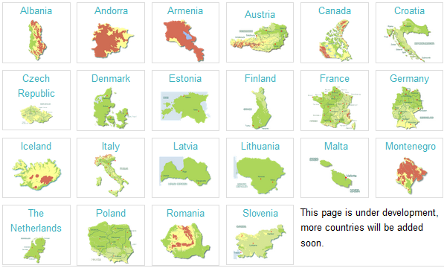
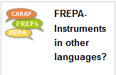
FREPA in your country

Slide 29

Plurilingual and intercultural competences:
descriptors and teaching materials
http://carap.ecml.at/

Slide 30
Linking FREPA and PluriMobil
FREPA descriptors (skills, knowledge, attitudes)
... were used to set clear goals for plurilingual and intercultural learning in mobility in the PluriMobil Lesson Plans
... can be used as a starting point to create new activities specific to a given school context before, during and after the mobility experience
...are an ideal base for the design of self-evaluation check-lists for plurilingual and intercultural competences/resources before and after the mobility experience

Slide 31
What do the FREPA and the Maledive have in common? They both…
use different pluralistic approaches to promote linguistic and cultural diversity in classrooms (e.g. awakening to languages, integrated didactics, intercultural approaches)
aim to give migrant and minority languages a solid place within language of schooling classes
foster the cooperation between teachers of all subjects by fixing common goals
FREPA descriptors can be used to support teaching and learning of the language of schooling

Slide 32
How can you benefit of our projects?
You have defined the development of plurilingual and intercultural competences as key objectives of school education?
All instruments and teaching materials are available online
Information about networks, events, publications
Training & Consultancy for different target groups and at different levels:
The team members will help …
identifying relevant elements of the instruments developed within our projects
adapting them to your context and
elaborating with you examples of use
Notes:
• teachers and teacher trainers
• minority and majority language educational
professionals
• networks and associations working in the
area of plurilingual and intercultural education
• ECML National Contact Points

Slide 33


